Slide 1
Forming and shaping plastics
& composite materials
Chapter - 18

Slide 2
Topics
Introduction
Extrusion
Injection molding
Structured foam molding
Blow molding
Rotational molding
Thermoforming
Compression molding
Casting
Process of composite materials

Slide 3
Extrusion
Raw materials in the form if thermoplastic pallets,granules,or powder, placed into a hopper and fed into extruder barrel.
The barrel is equipped with a screw that blends the pallets and conveys them down the barrel
Heaters around the extruder’s barrels heats the pellets and liquefies them
Screw has 3-sections
Feed section
Melt or transition section
Pumping section.

Slide 4
Complex shapes with constant cross-section
Solid rods, channels, tubing, pipe, window frames, architectural components can be extruded due to continuous supply and flow.
Plastic coated electrical wire, cable, and strips are also extruded
Pellets :extruded product is a small-diameter rod which is chopped into small pellets
Sheet and film extrusion :
Extruded parts are rolled on water and on the rollers

Slide 5
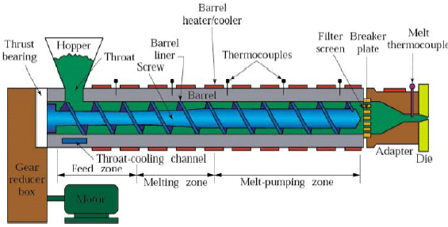
Extruder
Fig : Schematic illustration of a typical extruder for plastics, elastomers, and composite materials.

Slide 6
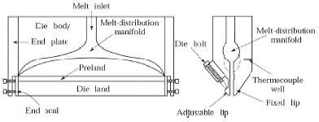
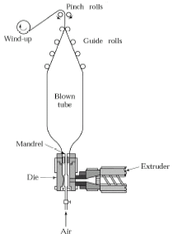
Sheet and Film Extruder
Fig : Die geometry (coat-hanger) for extruding sheet.
Fig : Schematic illustration of the production of thin film and plastic bags from tube first produced by an extruder and then blown by air.

Slide 7
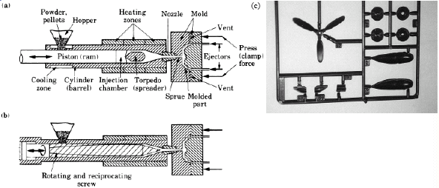
Injection molding
Fig : Injection molding with (a) plunger, (b) reciprocating rotating screw, (c) a typical part made from an injection molding machine cavity, showing a number of parts made from one shot, note also mold features such as sprues, runners and gates.

Slide 8
Injection molding
Similar to extrusion barrel is heated
Pellets or granules fed into heated cylinder
Melt is forced into a split-die chamber
Molten plastic pushed into mold cavity
Pressure ranges from 70 Mpa – 200 Mpa
Typical products : Cups, containers, housings, tool handles, knobs, electrical and communication components, toys etc.

Slide 9
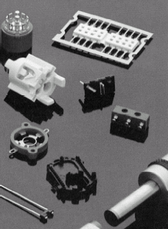
Injection molding
Injection molds have several components such as runners, cores, cavities, cooling channels, inserts, knock out pins and ejectors
3-basic types of molds
Cold runner two plate mold
Cold runner three plate mold
Hot runner mold
Fig : Examples of injection molding

Slide 10
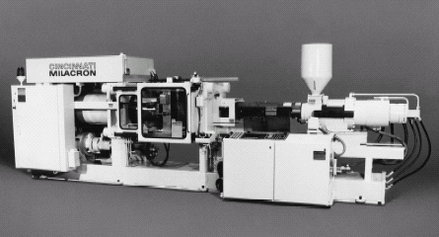
Injection Molding Machine
Fig : A 2.2-MN (250-ton) injection molding machine. The tonnage is the force applied to keep the dies closed during injection of molten plastic into the mold cavities.

Slide 11
Process capabilities :
High production rates
Good dimensional control
Cycle time range 5 to 60 sec’s
Mold materials- tool steels, beryllium - Cu, Al
Mold life- 2 million cycles (steel molds)
10000 cycles ( Al molds)
Machines :
Horizontal or vertical machines
Clamping – hydraulic or electric

Slide 12
Reaction Injection molding :
Mixture of resin with 2 or more reactive fluids forced into the mold cavity at high speed .
Applications : Bumpers, tenders, thermal insulation, refrigerators and freezers, water skis, stiffness

Slide 13
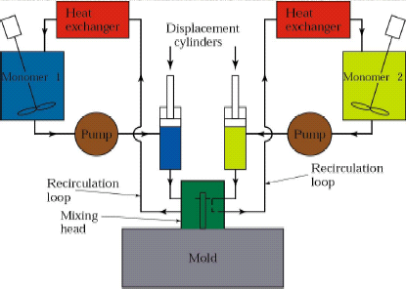
Reaction-Injection Molding
Fig : Schematic illustration of the reaction-injection molding process.

Slide 14
Blow molding
Modified extrusion and Injection Molding process.
A tube extruded then clamped to mold with cavity larger than tube diameter.
Finally blown outward to fill the cavity
Pressure 350Kpa-700Kpa
Other Blow Molding processes
Injection Blow molding
Multi layer Blow molding

Slide 15
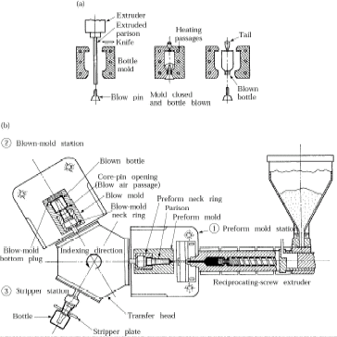
Blow molding
Fig : Schematic illustration of (a) the blow-molding process for making plastic beverage bottles, and (b) a three-station injection blow-molding machine.

Slide 16
Rotational Molding
Thermo plastics are thermosets can be formed into large parts by rotational molding
A thin walled metal mold is made of 2 pieces
Rotated abut two perpendicular axes
Pre-measured quantity of powdered plastic material is rotated about 2-axes
Typical parts produced-Trash cans, boat hulls, buckets, housings, toys, carrying cases and foot balls.

Slide 17
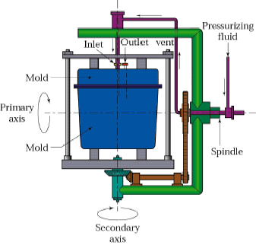
Rotational
Molding
Fig: The rotational molding (rotomolding or rotocasting) process. Trash cans, buckets, and plastic footballs can be made by this process.

Slide 18
Slush-molding
Plastisols are used in slush molding
Plastic materials are forced against the inside walls of the heated mold by tumbling action.
The part is cooled while it is still rotating and then removed by opening the mold

Slide 19
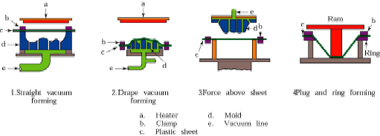
Thermoforming
Series process for forming thermoplastic sheet or film over a mold by applying heat and pressure.
Typical parts : advertising signs, refrigerator liner, packaging , appliance housing, and panels for shower stalls .
Fig : Various Thermoforming processes for thermoplastic sheet. These processes are commonly used in making advertising signs, cookie and candy trays, panels for shower stalls, and packaging.

Slide 20
Compression molding
Pre-shaped charge ,pre-measured volume of powder and viscous mixture of liquid resin and filler material is placed directly into a heated mold cavity.
Compression mold results in a flash formation which is a n excess material.
Typical parts made are dishes, handles, container caps fittings, electrical and electronic components and housings
Materials used in compression molding are thermosetting plastics & elastomers
Curing times range from 0.5 to 5 mins
3- types of compression molds are
Flash type
Positive type
Semi-positive

Slide 21
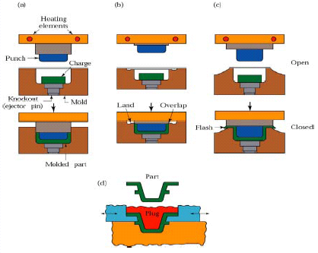
Compression Molding
Fig : Types of compression molding, a process similar to forging; (a) positive, (b) semi positive, (c) flash (d) Die design for making compression-molded part with undercuts.

Slide 22
Transfer molding
Transfer molding is an improvement if compression molding
Uncured thermosetting material placed in a heated transfer pot or chamber, which is injected into heated closed molds
Ram plunger or rotating screw feeder forces material into mold cavity through narrow channels
This flow generates heat and resin is molten as it enters the mold
Typical parts : Electrical & electronic components, rubber and silicone parts

Slide 23
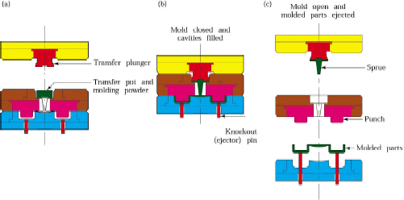
Transfer molding
Fig : Sequence of operations in transfer molding for thermosetting plastics. This process is particularly suitable for intricate parts with varying wall thickness.

Slide 24
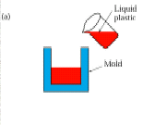
Casting
Conventional casting of thermo plastics :
Mixture of monomer, catalyst and various additives are heated and poured into the mould
The desired part is formed after polymerization takes place.
Centrifugal casting :
Centrifugal force used to stack the material onto the mold
Reinforced plastics with short fibers are used
Fig : Casting

Slide 25
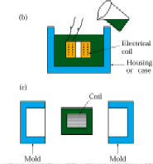
Potting & Encapsulation
Casting the plastic around an electrical component to embed it in the plastic is potting
In both the plastic is Dielectric
Fig : Potting & Encapsulation

Slide 26
Cold forming
Processes such as rolling ,deep drawing extrusion closed die forging ,coining and rubber forming can be used for thermoplastics at room temperatures
Typical materials used : Poly propylene, poly carbonate, Abs, and rigid PVC
Considerations :
Sufficiently ductile material at room temperature
Non recoverable material deformation
Solid Phase forming
Temperatures from 10ºc to 20ºc are maintained, which is below melting point
Advantages :
Spring-back is lower
Dimensional accuracy can be maintained

Slide 27
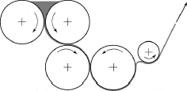
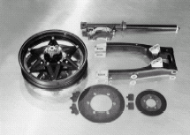
Calendaring and Examples of Reinforced Plastics
Fig : Schematic illustration of calendaring, Sheets produced by this process are subsequently used in thermoforming.
Fig : Reinforced-plastic components for a Honda motorcycle. The parts shown are front and rear forks, a rear swing arm, a wheel, and brake disks.

Slide 28
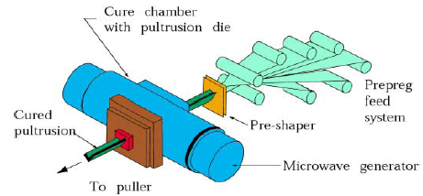
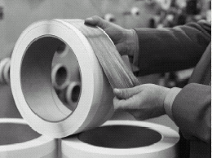
Prepegs
a
b
Fig : (a) Manufacturing process for polymer-matrix composite. (b) Boron-epoxy prepeg tape.

Slide 29
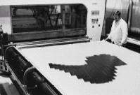
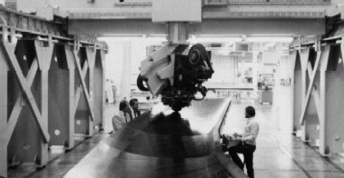
Tape Laying
Fig : (a) Single-ply lay-up of boron-epoxy tape for the horizontal stabilizer for F-14 fighter aircraft. (b) A 10 axis computer-numerical controlled tape-laying system. This machine is capable of laying up 75 mm and 150 mm (3 in. and 6 in.) wide tapes, on contours of up to 30 and at speeds of up to 0.5m/s.

Slide 30
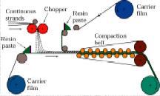
Sheet Molding
Fig : The manufacturing process for producing reinforced-plastic sheets. The sheet is still viscous at this stage; it can later be shaped into various products.

Slide 31
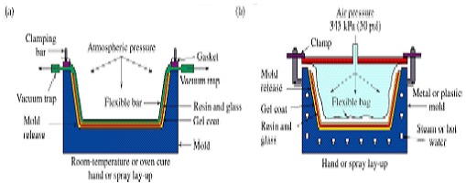
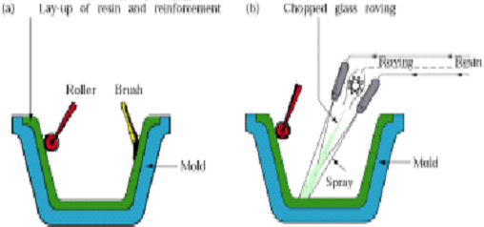
Examples of Molding processes
Fig : (a) Vacuum-bag forming. (b) Pressure-bag forming.
Fig : Manual methods of processing reinforced plastics: (a) hand lay-up and (b) spray-up. These methods are also called open-mold processing.

Slide 32
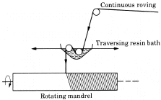
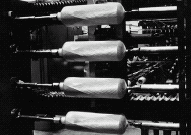
Filament Winding
Fig : (a) Schematic illustration of the filament-winding process. (b) Fiberglass being wound over aluminum liners, for slide-raft inflation vessels for the Boeing767 aircraft.

Slide 33
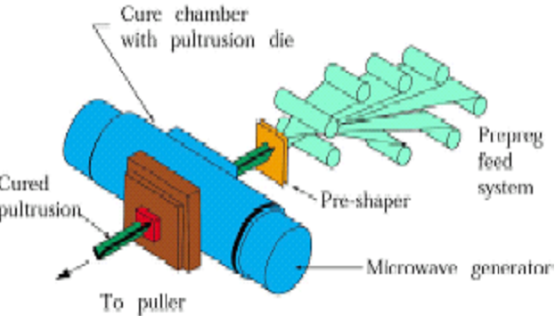
Pultrusion
Fig: Pultrusion Process

Slide 34
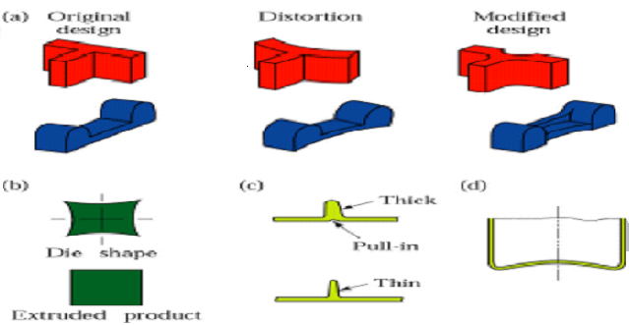
Design Modifications to Minimize Distortions
Fig : Examples of design conditions to eliminate or minimize distortion of plastic parts. (a) Suggested design changes to minimize distortion. (b) Die design for extrusion of square sections.Without this design, product cross sections swell (c) Design change in a rib,to minimize pull-in caused by shrinkage during cooling. (d) Stiffening the bottoms of thin plastic containers by the bottoms of thin plastic containers by doming-this technique is similar to the process used to make the bottoms of Al. beverages cans.

Slide 35
THE END

